Slide 1
Sales Forecasting
Using LSTMs - SARIMA Hybrid Model
Minor Project in the course “Computational Intelligence”
Byri Sahas Reddy 200001017, Tadi Dinesh Kumar Reddy 200001075
Under the supervision of
Dr. Aruna Tiwari
Professor, CSE.

Slide 2
Problem Definition
The goal is to predict the future sales of a certain product(s) based on historical sales data and other relevant factors such as marketing efforts, economic conditions and consumer behavior
This assists in making informed business decisions, businesses can better manage their inventory levels, ensuring that they have the right products in stock at the right time that is planning for future demand by identifying patterns and trends in sales data.

Slide 3
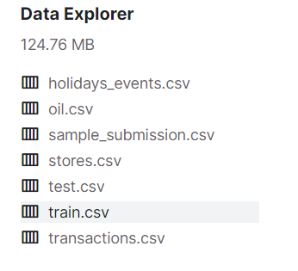
DATA
The dataset used for this project is the Corporación Favorita Grocery Sales Forecasting provided by the Corporación Favorita, from Kaggle. It consists of a very diverse multivariate data collected across several stores across Ecuador over a period of more than 4 years.
Link to the dataset

Slide 4
Train.csv has time series of features store_nbr, family, and onpromotion as well as the target sales.
Test.csv has the same features as the training data. We will predict the target sales for the dates in this file.
Oil.csv contains the daily oil prices
Holidays_events.csv has information about holidays

Slide 5
Data Preprocessing
We want to predict the total sales of a certain product over all the Corporación Favorita stores in Ecuador, to do so we first need to collect different features for all the transactions that occurred over our training period. We shall be using the Poultry sales data to train and predict using our model, along with this is also the data about the oil prices in the country during this period, we shall also be using the information about the whether the particular day is a holiday, weekday, end of the year, and so on. We also hold the information about whether that particular product is under promotion on that date. So, the first step involves the importing of all this data into Pandas dataframes, and merge them together to form our training and testing datasets.
Once the dataframes are obtained, we need to compute the total sales for our product across all of the stores, this also involves taking the cumulative of whether the product is on promotion

Slide 6
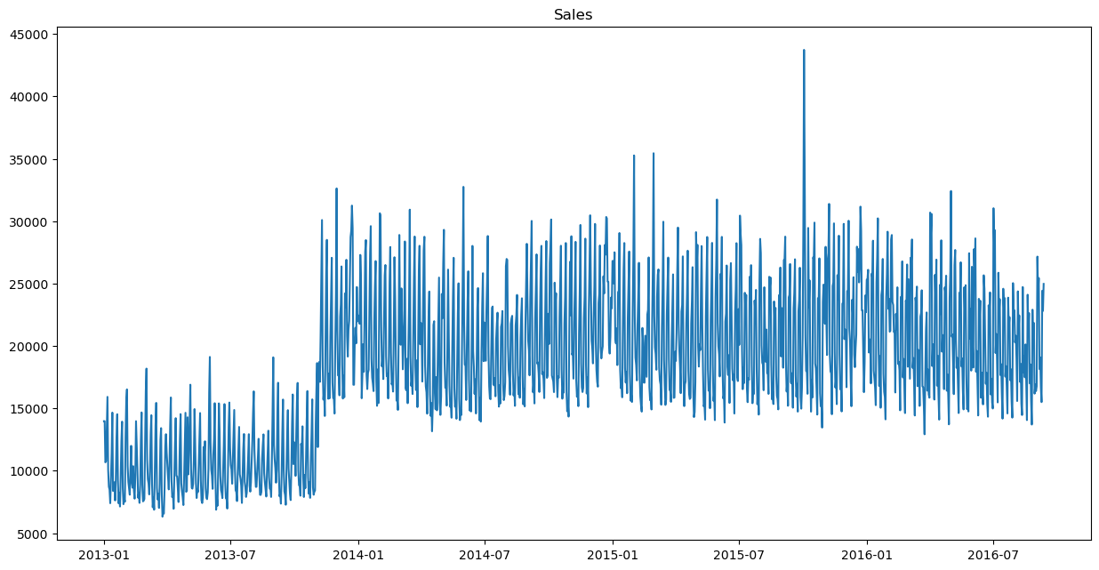
Following is the graph of the total poultry sales across all the stores over more than 4 years

Slide 7
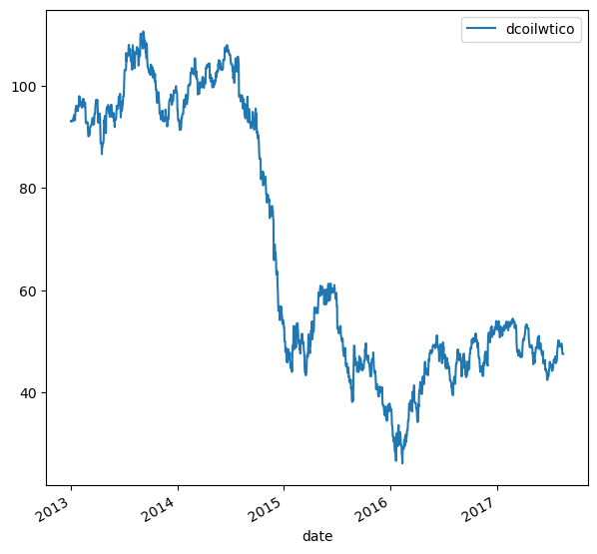
Graph of oil prices in Ecuador

Slide 8
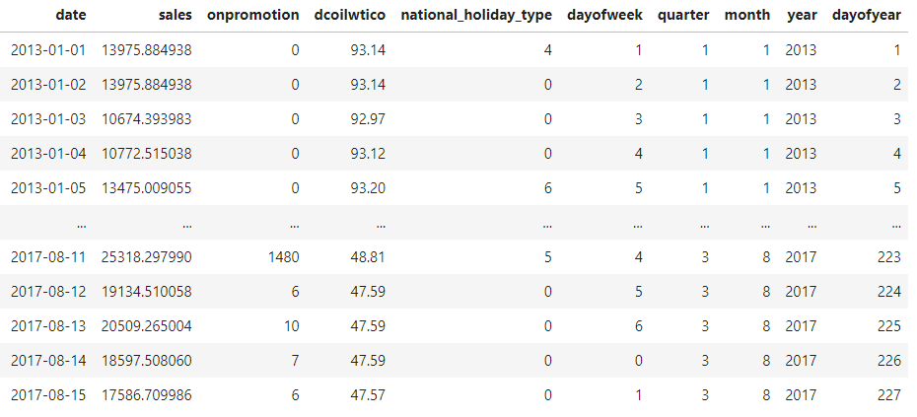
There are some abnormalities in the dataset where the sales on certain days are too low, presumably when the sales data was not collected on a particular day, We remove these exceptions by replacing with nan values
The sales and oil prices have some null/nan values across the dataset, we are using the Numpy fillna() function to fill the null values with the values from the day before
Once done we merge the dataframes, drop any unnecessary columns
The holidays csv file is converted into a dataframe by properly indexing the ‘day of the week’, ‘quarter’, ‘month’, ‘year’, ‘day of the year’.
This dataframe is also merged with the sales dataframe, and the index is set to ‘date’ as we are dealing with time series data.
The matter of considering which columns are finally taken for training is done by training the model several times with different column features, to verify if the columns are helpful in training or not.
We have decided after a fair test of trial and error to use the following columns as below

Slide 9
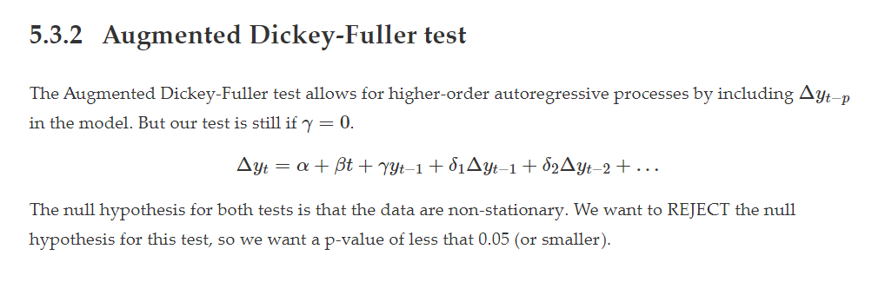
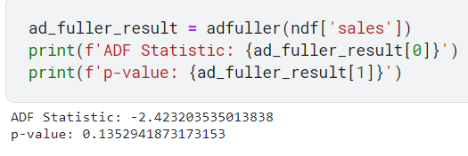
The data is now to be trained using the SARIMA model, to do so we need to identify the seasonality or trends and calculate the parameters used for training the SARIMA model on our dataset
To do so we use the ADF test as described below
We use the imported ADF testing libraries to test for the p-value and plot the Autocorrelation graphs

Slide 10
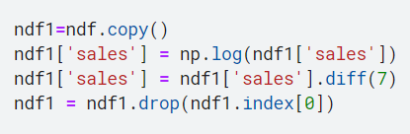
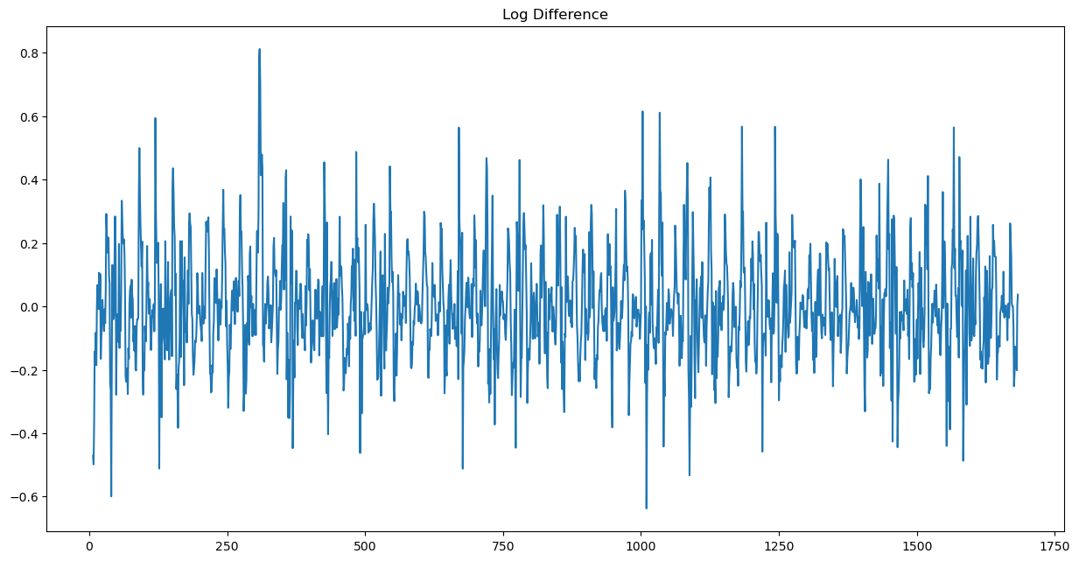
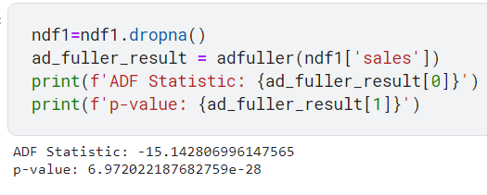
The number of times the ADF test need to be performed depends on the p-value obtained, if the p-value fall under the acceptable range then the test can be stopped and the exogenous parameters are confirmed by looking at the correlation graphs.
The above logarithmic differencing is done for the data until the ADF test is passed.
The log difference for the sales data is as shown the graph to the right, the ADF test is computed on this dataframe to test for the p-value (as seen above compute the new p-value, which now lies in the required range that is, less than 0.05. )

Slide 11
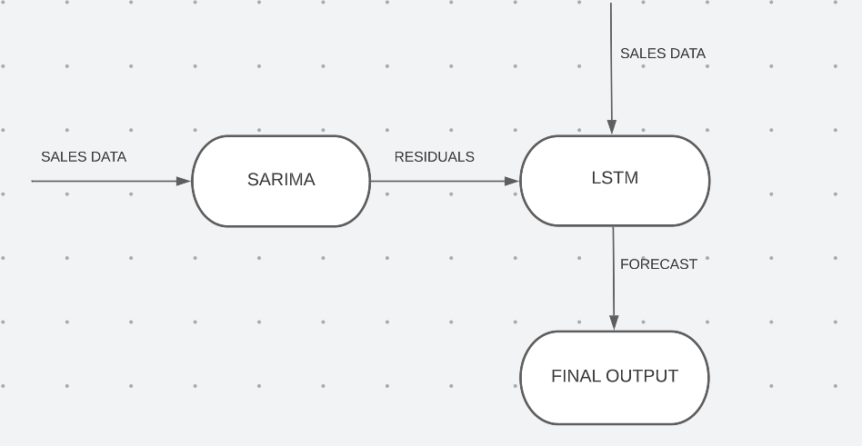
Model Architecture

Slide 12

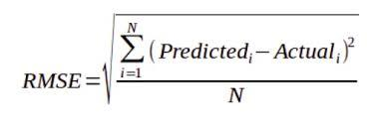
Evaluation Metrics
Root Mean Squared Log Error (RMSLE)
Root Mean Squared Error (RMSE)

Slide 13

SARIMAX
The SARIMA model works by decomposing a time series into its components: trend, seasonality, and residuals.
The parameters p, d, and q are used to model the non-seasonal component of the time series, while the parameters P, D, and Q are used to model the seasonal component of the time series

Slide 14
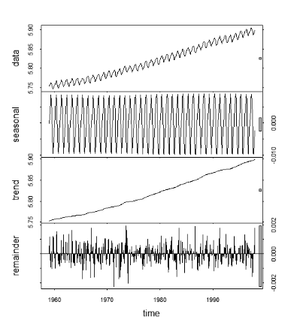
SARIMAX
The trend component represents the long-term changes in the data, while the seasonality component captures the periodic fluctuations that occur at fixed intervals.
Example Ref : https://i.stack.imgur.com/4ikbj.png

Slide 15
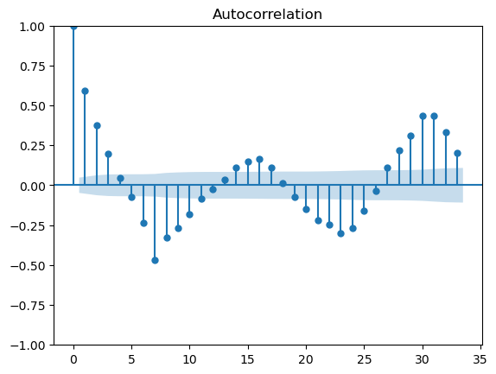
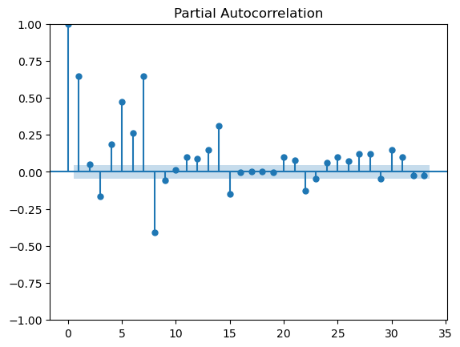

The Autocorrelation and partial Autocorrelation graphs help us calculate the exogenous parameters for the training model, we need to set the proper parameters for a given dataset without which the model may not converge.
The graphs shown above help us calculate the parameters to be set as shown below

Slide 16
SARIMAX
Choosing the parameters (p, d, q) , (P, D, Q)_{m}
order=(1, 1, 1), seasonal_order=(3, 1, 1, 7)

Slide 17
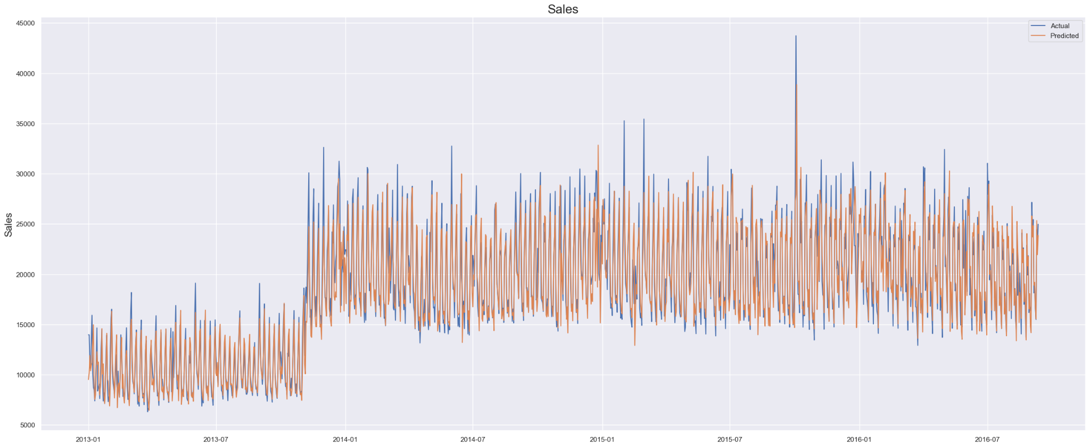
Plot on Train Data

Slide 18
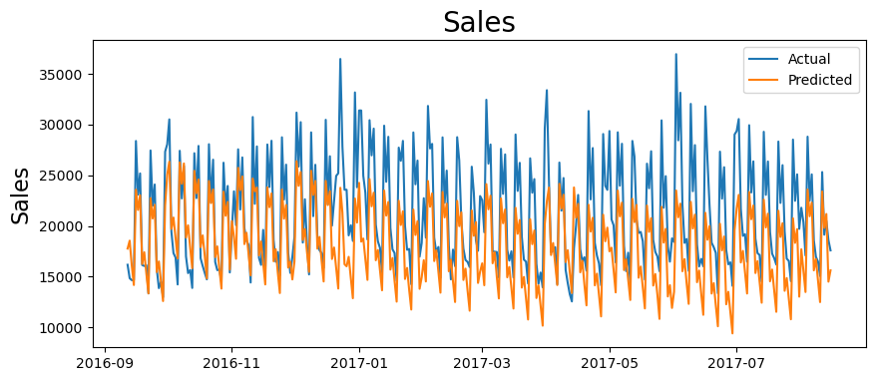
Test data predictions using SARIMA (RMSLE : 0.214, RMSE : 4446)

Slide 19
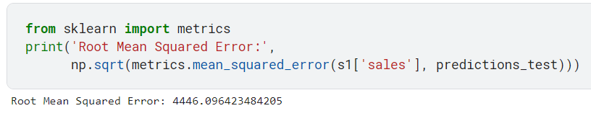
Following is the Root Mean Squared Error evaluated on the test data on SARIMA
The RMS Error is lot higher than expected, which we will later on show that it can be improved a lot more using our Hybrid LSTM - SARIMA Model.

Slide 20
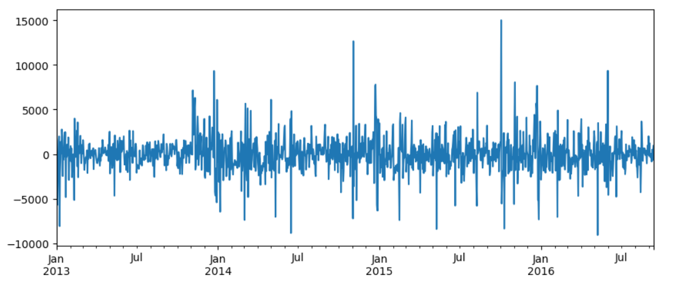
Residual Plot from training data predicted using SARIMA

Slide 21
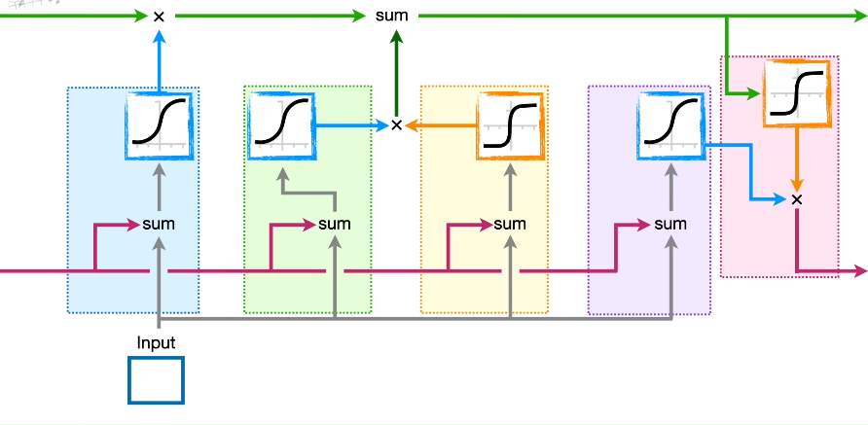
LSTM
The architecture of an LSTM (Long Short-Term Memory) network is based on a cell that has the ability to maintain a memory state over time and selectively update or erase this memory.
The basic structure of the LSTM architecture includes three main components: the input gate, the forget gate, and the output gate.
These gates control the flow of information into and out of the cell, and are modulated by activation functions that enable the LSTM to learn long-term dependencies in a sequence.

Slide 22
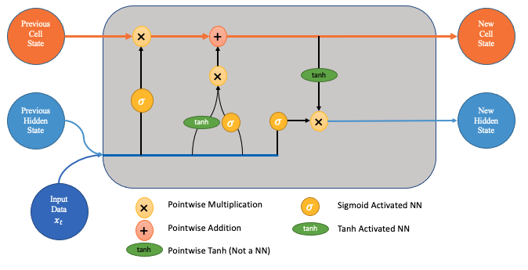
LSTM
The LSTM architecture also includes a peephole connection, which allows the cell state to directly influence the input and forget gates. This enables the LSTM to more selectively control the flow of information into and out of the cell and can improve the performance of the network.
The LSTM architecture is well-suited to a wide range of sequence modeling tasks, as it allows the network to selectively remember or forget information over long sequences, making it a powerful tool for tasks such as natural language processing, speech recognition, and time series prediction

Slide 23
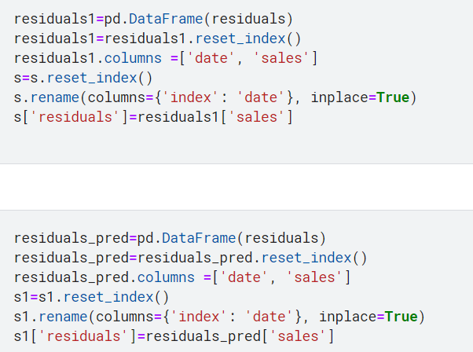
The use of LSTMs for time-series data is widely known, as such several different architectures can be tried out, depending on the dataset.
We shall be using the pre-defined Keras LSTM libraries to define the architecture of the LSTM for training on the dataset.
LSTMs use tanh activation which makes the model sensitive to magnitudes, so proper preprocessing steps are to be followed, so that the model can converge on the data.
The first step is to prepare our dataset, which we do by merging the residuals obtained from SARIMA model to the original dataframe, the following is done as shown below.

Slide 24
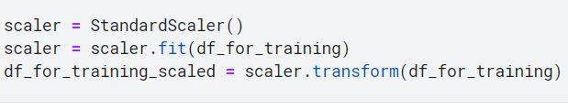
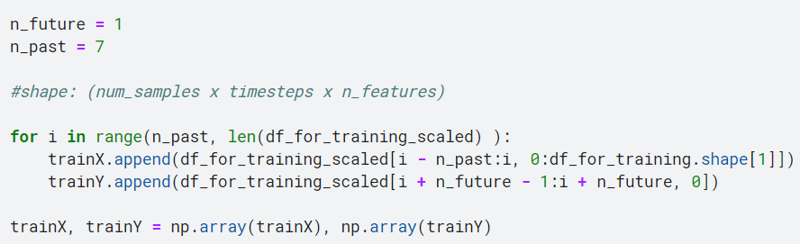
Once the dataset is ready we preprocess the dataset by using the StandardScalar function as given below
We shall now set some parameters to prepare our data that shall be fed to our LSTM model for training
We shall use 7 days worth data to make a prediction one day in the future, this is how the LSTM is progressively trained. As such we create our trainX and trainY numpy arrays as follows

Slide 25
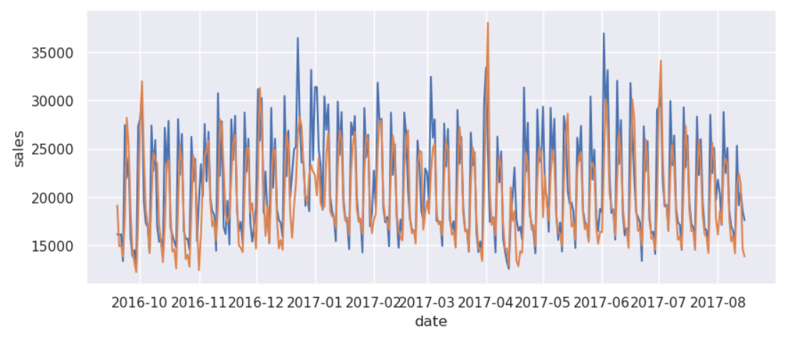
The sales data trained independently on LSTM architecture gives
As noticeable there are several deviations from the expected values
Also closely notice both the trend and magnitude expected is far from the predicted

Slide 26
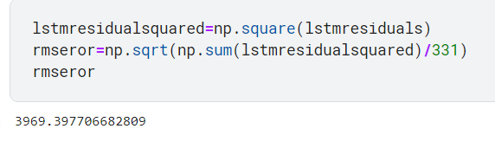
The sales data trained independently on LSTM architecture, gives the following Root Mean Squared Error, for its predictions on the last 330 days (test data)
So it stands to reason from the graph before that we need to include better features as in what we are about to do in our Hybrid model by including the residuals from SARIMA model as a feature in training data for LSTM, this can be done by merging the residuals into the training dataset

Slide 27
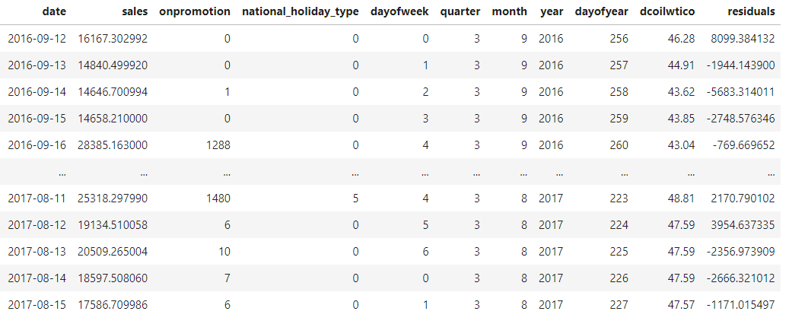
The sales data after introducing the new feature ‘residuals’ merged to the original training data with the residuals obtained from training the SARIMA model gives the following new train dataframe
We now supply this data to our LSTM Model after applying the StandardScalar transforms

Slide 28
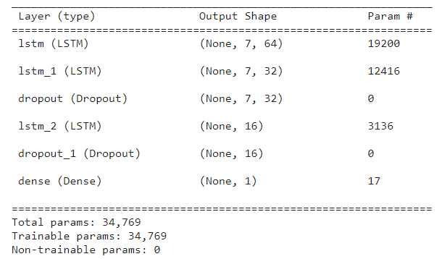
Hybrid LSTM Model Architecture
We have defined our LSTM architecture for our Hybrid Model as follows
The architecture again, has been decided through a series of trial and error, based on the requirements of the dataset being used, among the experimented architectures, the best is as follows
We have used a total of 3 LSTM layers including dropout layers (to avoid overfitting).
As noticeable, the output shape from the LSTM layers is 7 x 64 and so on, the 7 here indicates our parameter we set earlier where in we decided to use 7 days data from the past to predict one day in the future

Slide 29
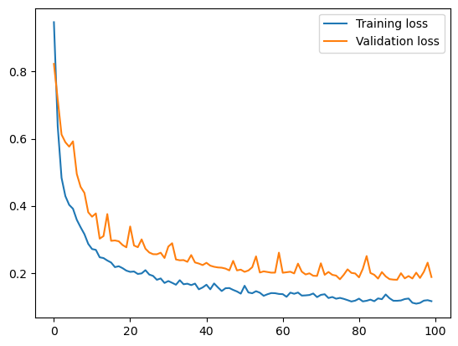
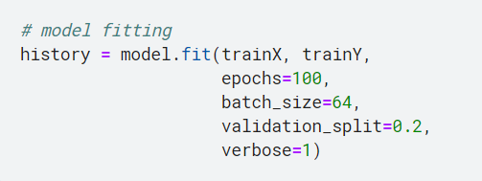

We are using the Mean Squared Error as the metric to compile and train our model, using the built-in Adam Optimizer for 100 epochs, with a batch size of 64 and a validation split of 0.2 as shown below
Final Loss
At 100 Epochs
The variation of training loss and validation loss is as shown in the graph to the right
Epochs, batch size and architecture were adjusted so as to not undefit or overfit the data.
The training converges within 100 epochs

Slide 30
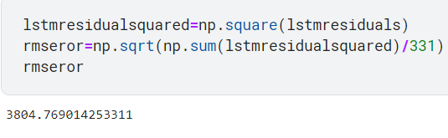
The sales data trained on our Hybrid LSTM - SARIMA Model, gives the following Root Mean Squared Error, for its predictions on the last 330 days (test data)
As seen the RMS Error is much better than both the SARIMA and LSTM models trained independently
This confirms our hypothesis that the Hybrid Model is better performing than the independent models.

Slide 31
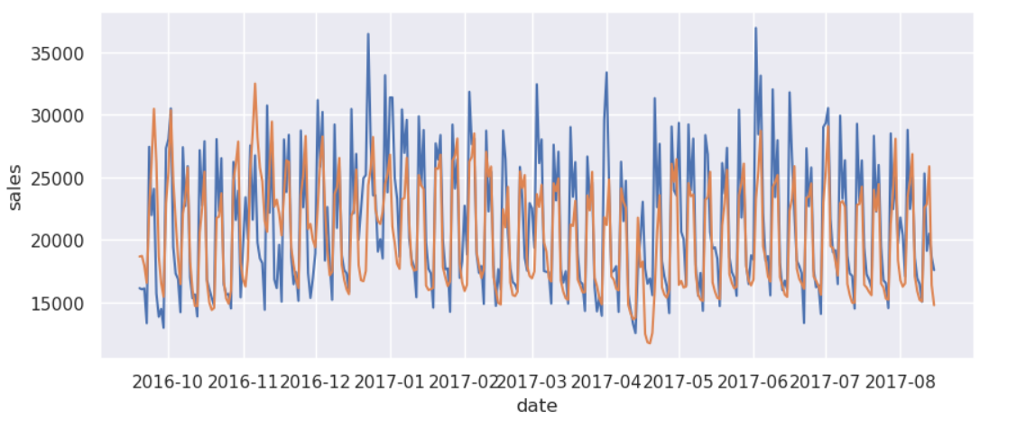
Test data predictions using LSTM with residuals (RMSLE : 0.168, RMSE : 3804)

Slide 32
REFERENCES
Fattah J, Ezzine L, Aman Z, El Moussami H, Lachhab A. Forecasting of demand using ARIMA model. International Journal of Engineering Business Management. 2018;10. doi:10.1177/1847979018808673
Woo, Gerald, et al. "ETSformer: Exponential Smoothing Transformers for Time-series Forecasting." arXiv preprint arXiv:2202.01381 (2022).
Zunic, Emir, et al. "Comparison Analysis of Facebook's Prophet, Amazon's DeepAR+ and CNN-QR Algorithms for Successful Real-World Sales Forecasting." arXiv preprint arXiv:2105.00694 (2021)
Vallés-Pérez, Iván, et al. "Approaching sales forecasting using recurrent neural networks and transformers." Expert Systems with Applications 201 (2022): 116993
https://miro.medium.com/max/674/1*jikKbzFXCq-IYnFZankIMg.png
https://statquest.org/long-short-term-memory-lstm-clearly-explained/
https://morioh.com/p/f22da5e3137f
https://i.stack.imgur.com/4ikbj.png

Slide 33
THANK YOU

